Slide 1

Biodiversity Informatics (AKA “Phyloinformatics”) http://iphylo.org/~rpage/phyloinformatics
@rdmpage
Room 510
Graham Kerr Building
Roderic.Page@glasgow.ac.uk

Slide 2




Administrivia
Lectures + exercises on web site
Add comments on the course web site
Project deadline 20 February 2020
http://iphylo.org/~rpage/phyloinformatics

Slide 3
What is “biodiversity informatics”?

Slide 6
Linking biodiversity data together

Slide 7
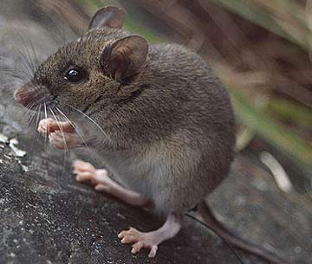
Apomys datae

Slide 8
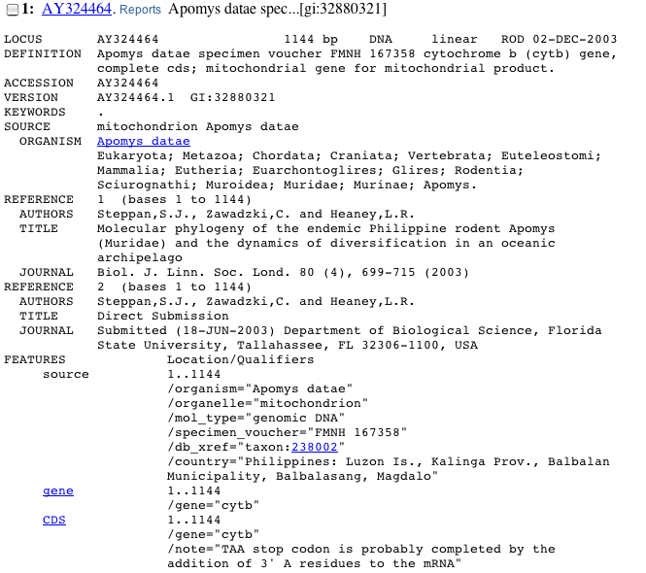

Slide 9
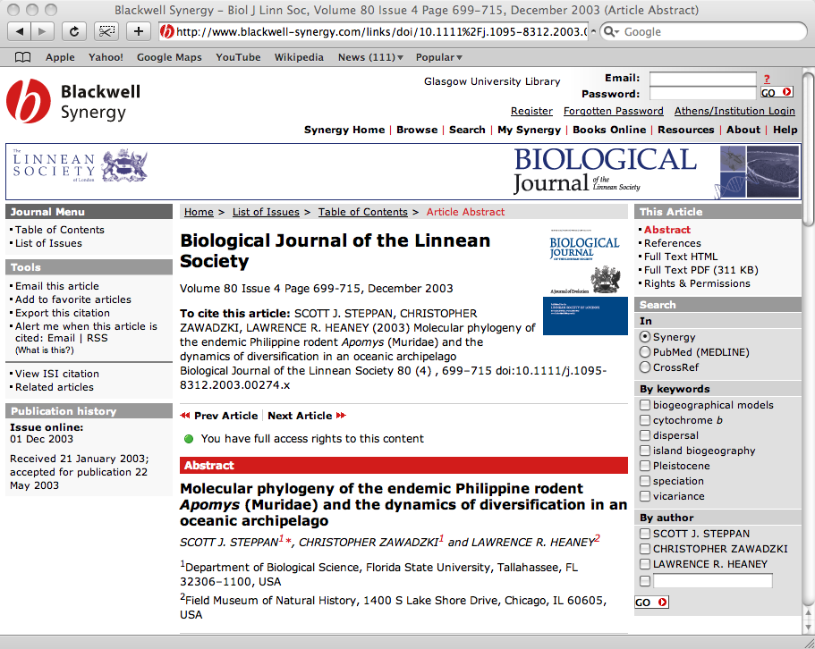

Slide 10
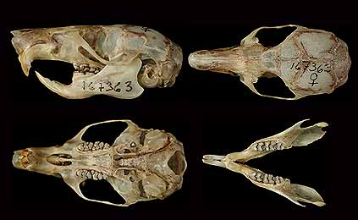
Apomys specimen

Slide 11
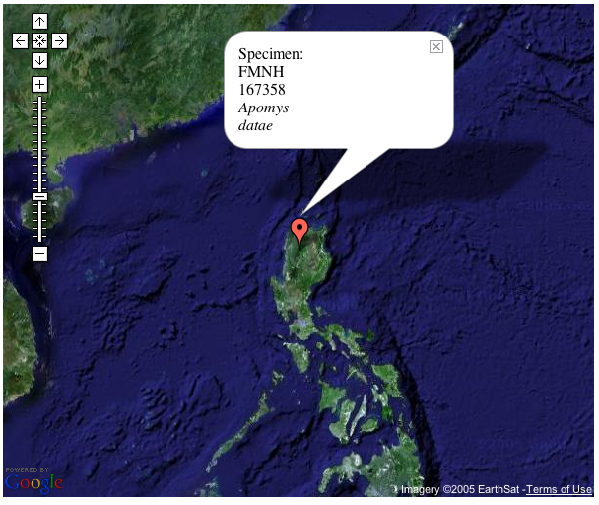

Slide 12
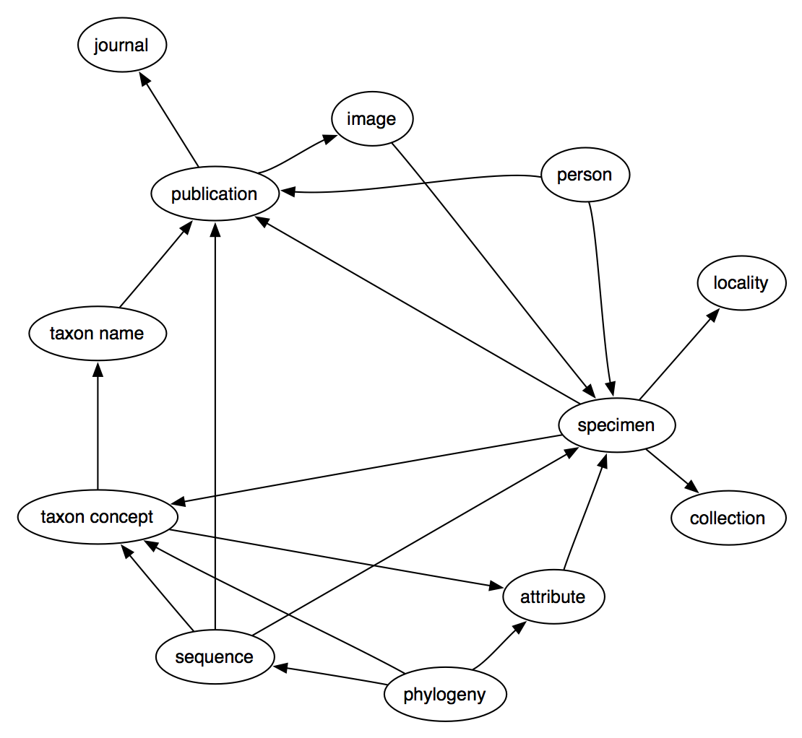
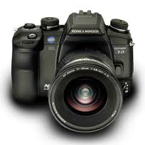





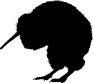


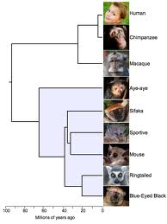

Slide 13
Our questions span multiple databases (“paths” in network)

Slide 14
Phylogeography

Slide 15
Taxonomy

Slide 17
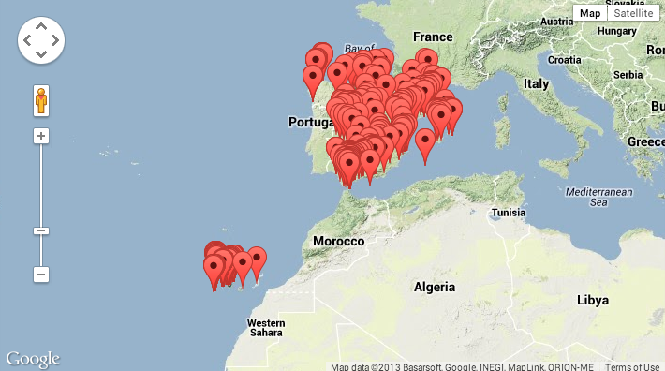
GenBank records from Spain

Slide 18
How do we integrate these data?

Slide 19
Why integrate?

Slide 20
Learn stuff we don’t know

Slide 21

There are known knowns, things we know that we know
There are known unknowns, things we now know we don’t know
But there are also unknown unknowns, things we do not know we don't know

Slide 22
knowns
unknowns
known
unknown

Slide 23
Things we know …without knowing that we know

Slide 24
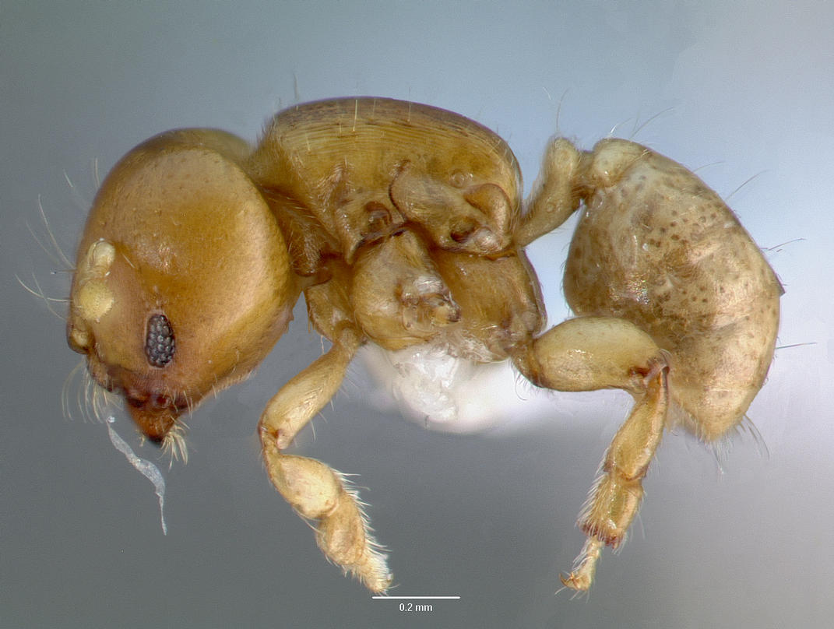
Melissotarsus insularis
Notes:
This ant illustrates a case where three different data source (NCBI, AntWeb, journal supplementary material) are needed to discover that, in fact, GenBank has sequences for this ant.

Slide 25


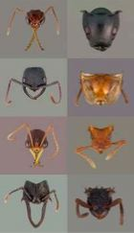
1
Melissotarsus insularis
no hit
Melissotarsus insularis
CASENT0107663-D01
CASENT0107663-D01
DQ176312
DQ176312
Melissotarsus sp. BLF m1
=
Melissotarsus sp. BLF m1
Melissotarsus insularis
Notes:
If you search NCBI for “Melissotarsus insularis” you find nothing. If you search AntWeb you find some specimens, one of which is CASENT0107663-D01. In the Phils Trans barcoding paper the supplementary material (also online in BoLD) shows that CASENT0107663-D01 has been sequenced, yielding a COI sequence with accession number DQ176312. If you go back to GenBank and look up the accession number you discover the taxon “Melissotarsus sp. BLF m1”, which must be the same as Melissotarsus insularis. Hence, GenBank should actually say “yes, I have information on Melissotarsus insularis”. There is latent knowledge in these data sources that we miss if they remain in ignorance of each other.

Slide 26
No one source has all the answers

Slide 27
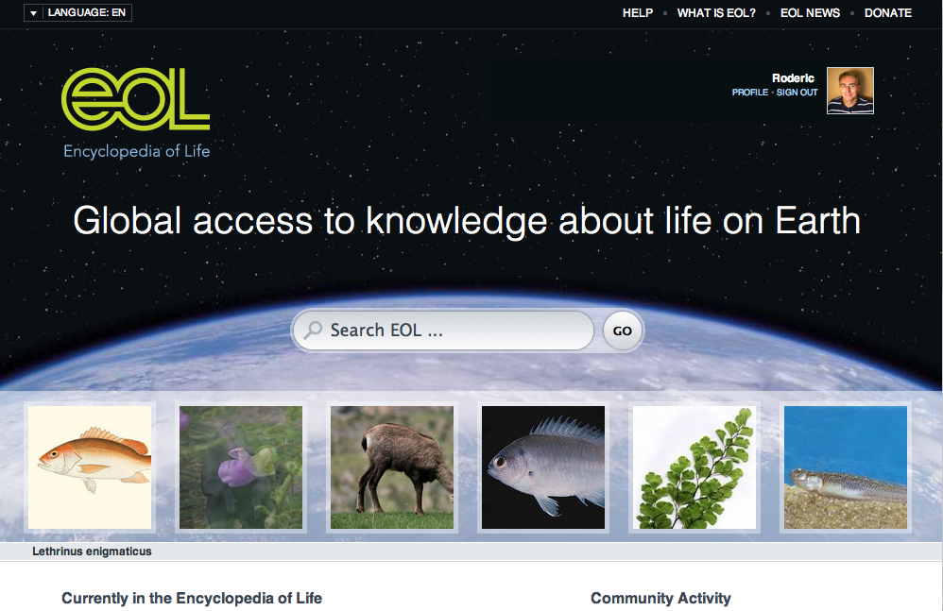
Notes:
http://www.eol.org

Slide 28


Slide 29
Single source

Slide 30
Many sources

Slide 31
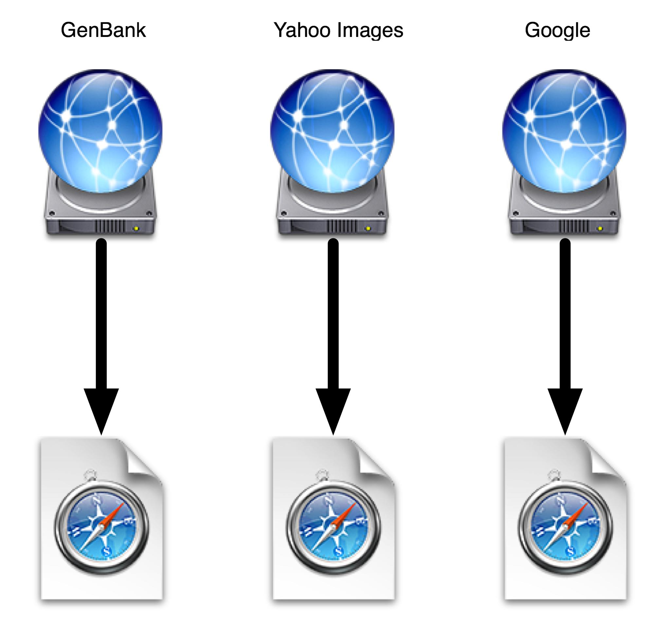

Slide 32
Combine sources

Slide 33
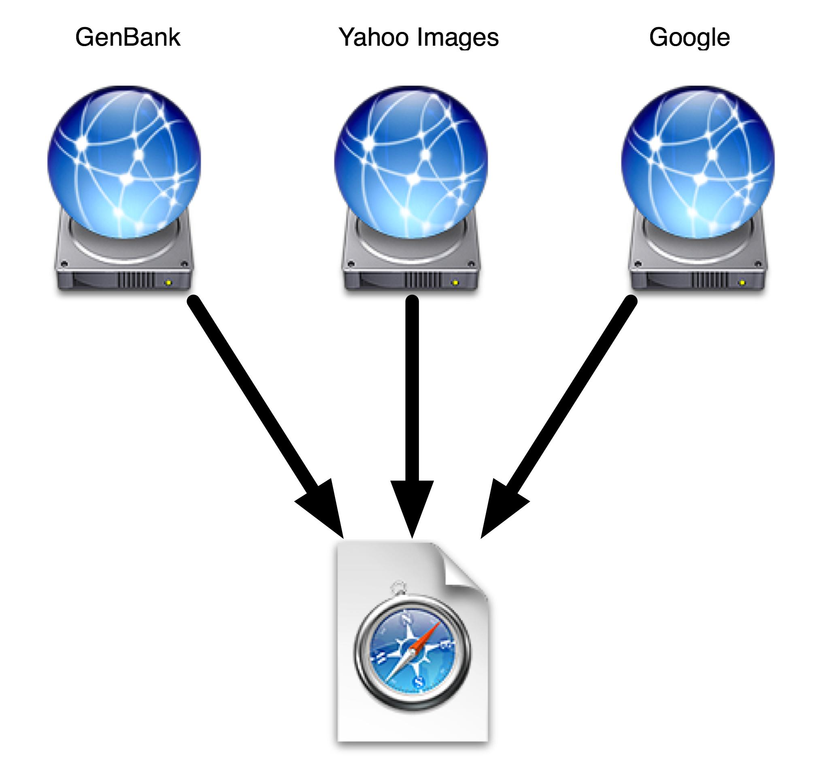

Slide 34
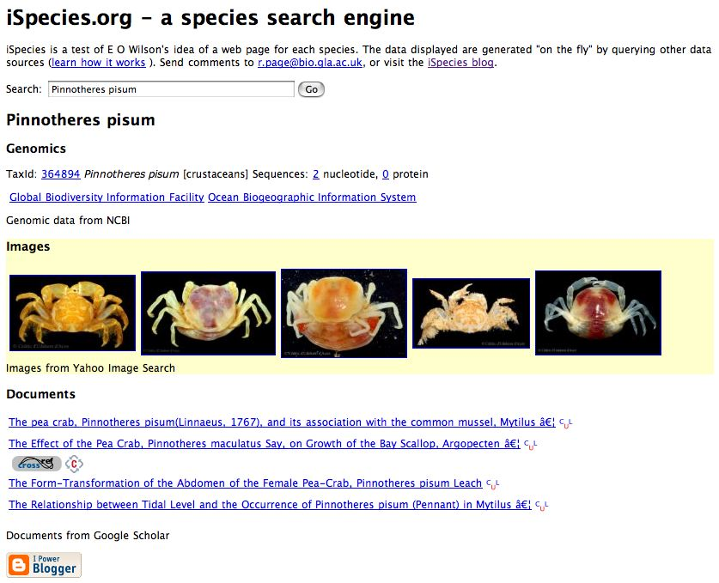
ispecies.org

Slide 35
Linking
Finding information about organisms
Linking together in “mashups”

Slide 36
Geography

Slide 37
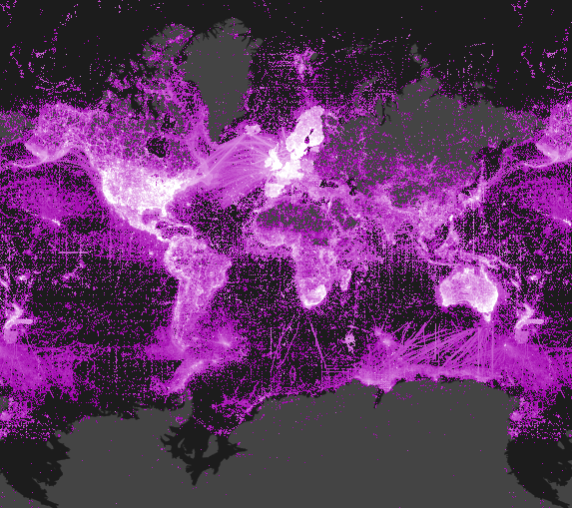
GBIF.org 600+ million records

Slide 38

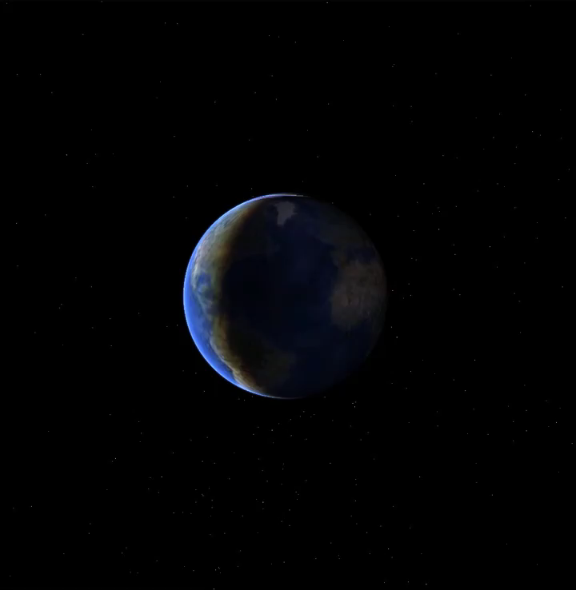
@rdmpage
Notes:
http://iphylo.blogspot.com/2007/06/earth-not-flat-official.html

Slide 39

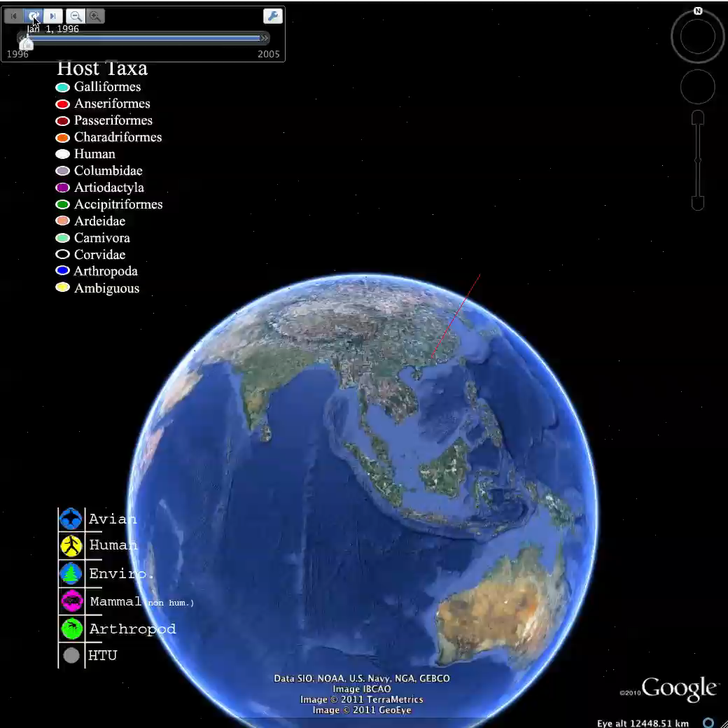
@andrewxhill
Notes:
http://systbio.org/?q=node/184, see http://dx.doi.org/10.1080/10635150701266848

Slide 40
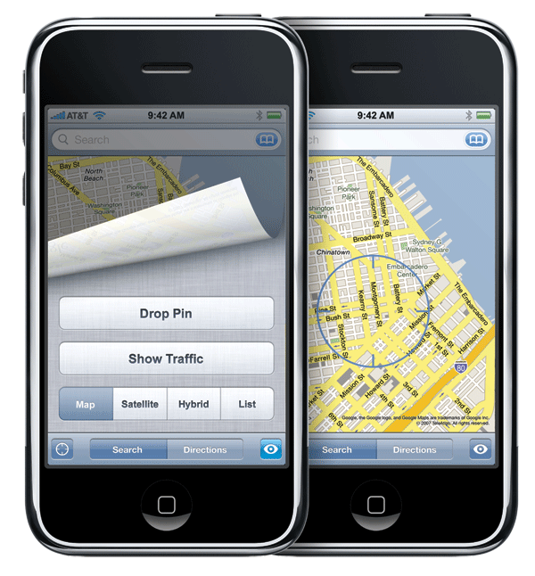

Slide 41
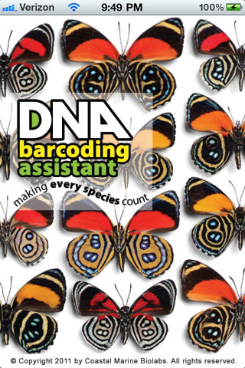
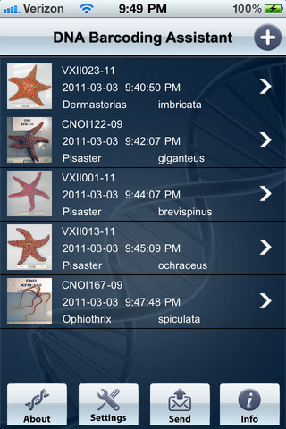

Slide 42
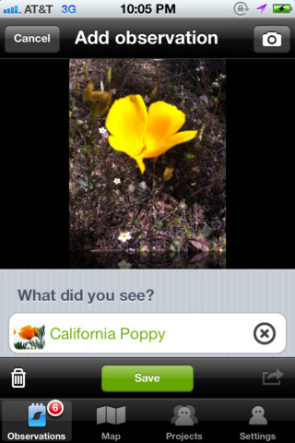
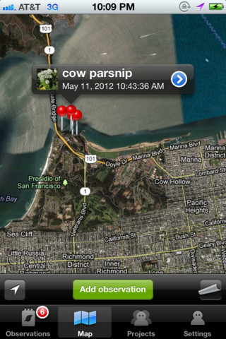
iNaturalist

Slide 43
Geography
Species distributions
Geophylogenies

Slide 44
Taxonomy

Slide 45
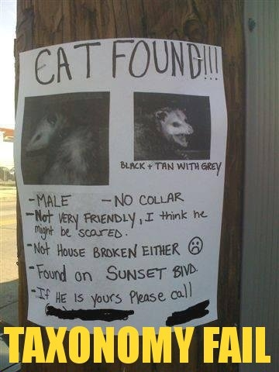

Slide 46
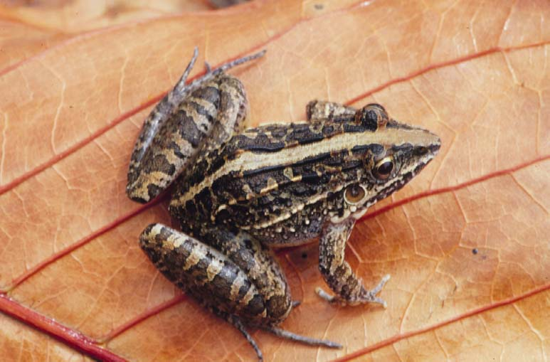
Names can change… Leptodactylus fuscus (Schneider)
Rana fusca Schneider
1802 Rana typhonia Sonnini & Latreille
1803 Rana typhonia Daudin
1824 Rana sibilatrix Wied
1826 Leptodactylus typhonius Fitzinger
1841 Cystignathus typhonius Dumeril & Bibron
1843 Leptodactylus typhonius Fitzinger
1858 Cystignathus fuscus Günther
1882 Leptodactylus typhonius Boulenger
1927 Leptodactylus sibilatrix Müller
1935 Leptodactylus sibilatrix Parker
1968 Leptodactylus fuscus Heyer

Slide 47
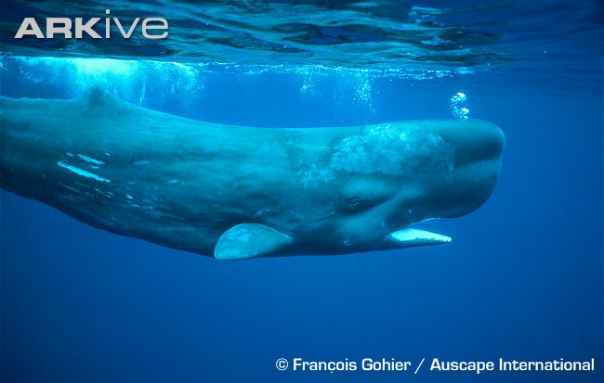

Slide 48
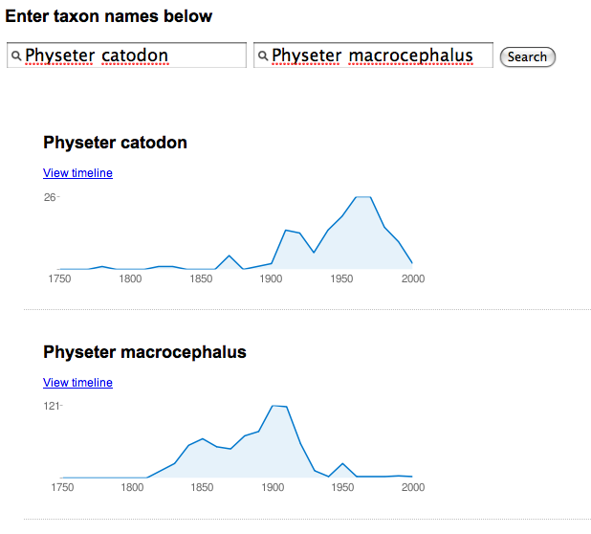

Slide 49
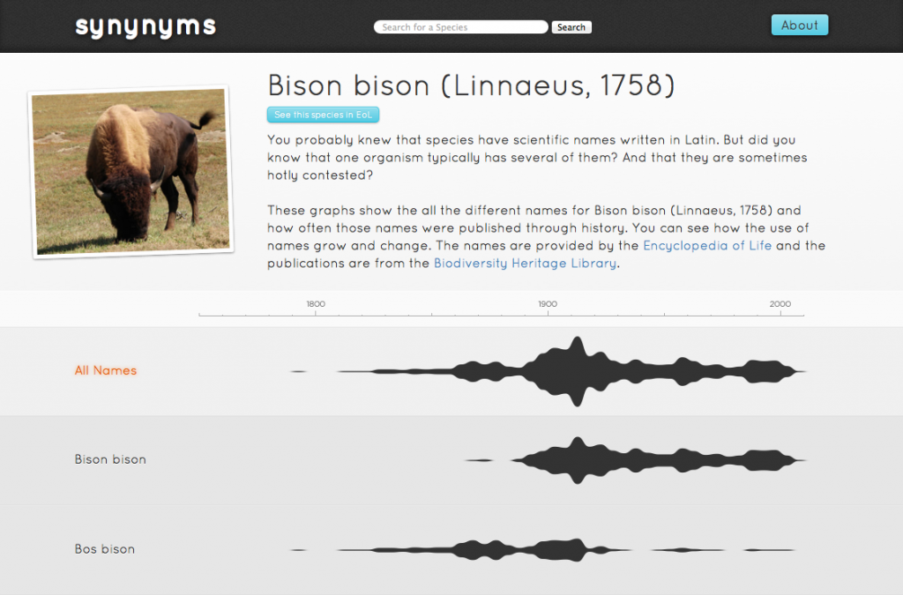

Slide 50

Taxonomy as a source of data

Slide 51
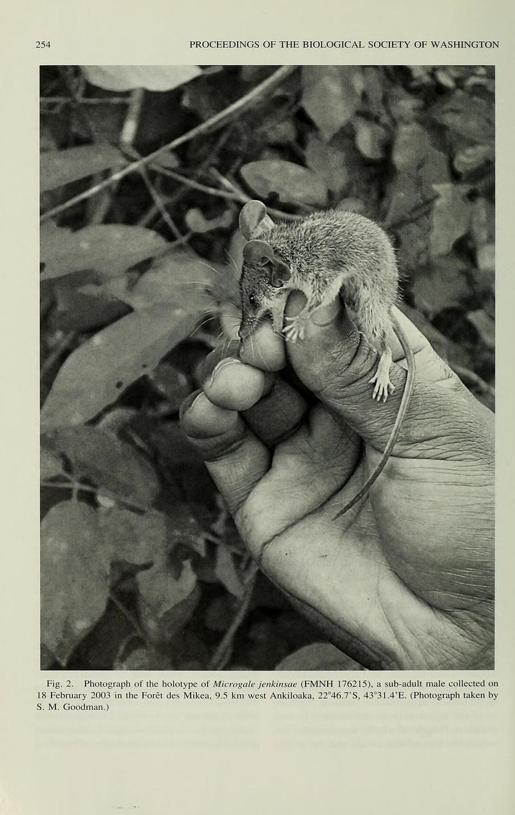

Slide 52
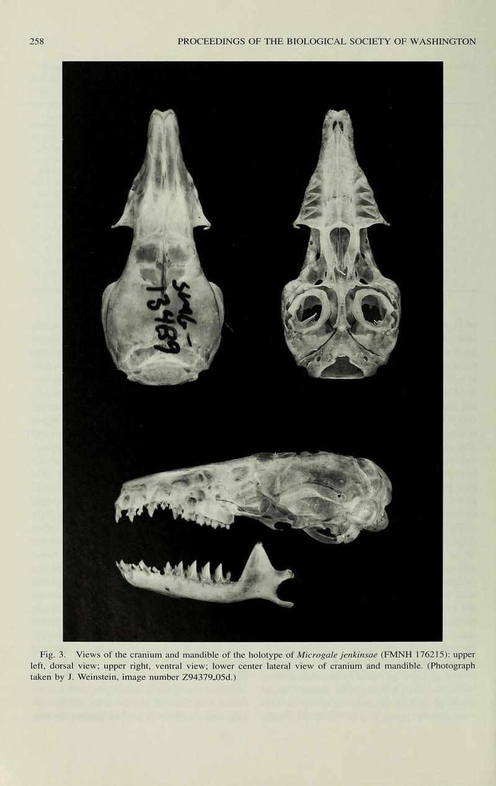

Slide 53
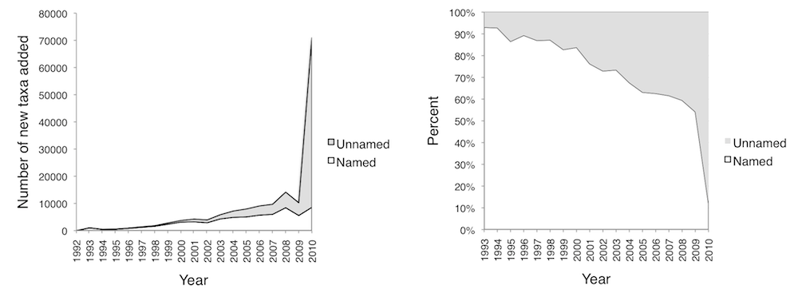
“Dark taxa”

Slide 54
Classification

Slide 55
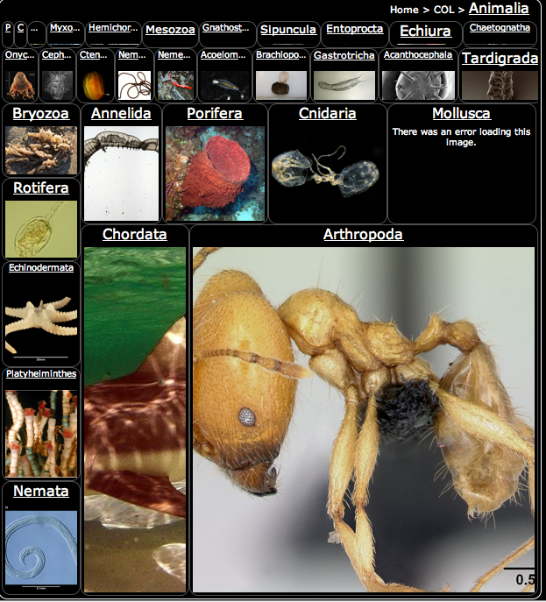
http://synthesis.eol.org/media/treemap/

Slide 56

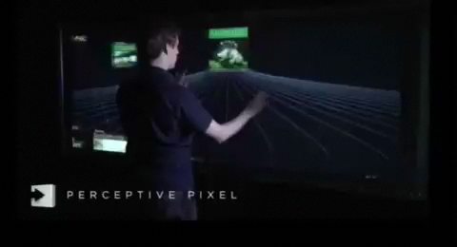
@kzelnio
Think how great of a tool that could be at museums
on a large flat screen at 4 year old height.
Notes:
http://www.perceptivepixel.com/ and http://iphylo.blogspot.com/2008/08/perceptive-pixel-taxonomy-demo.html

Slide 57
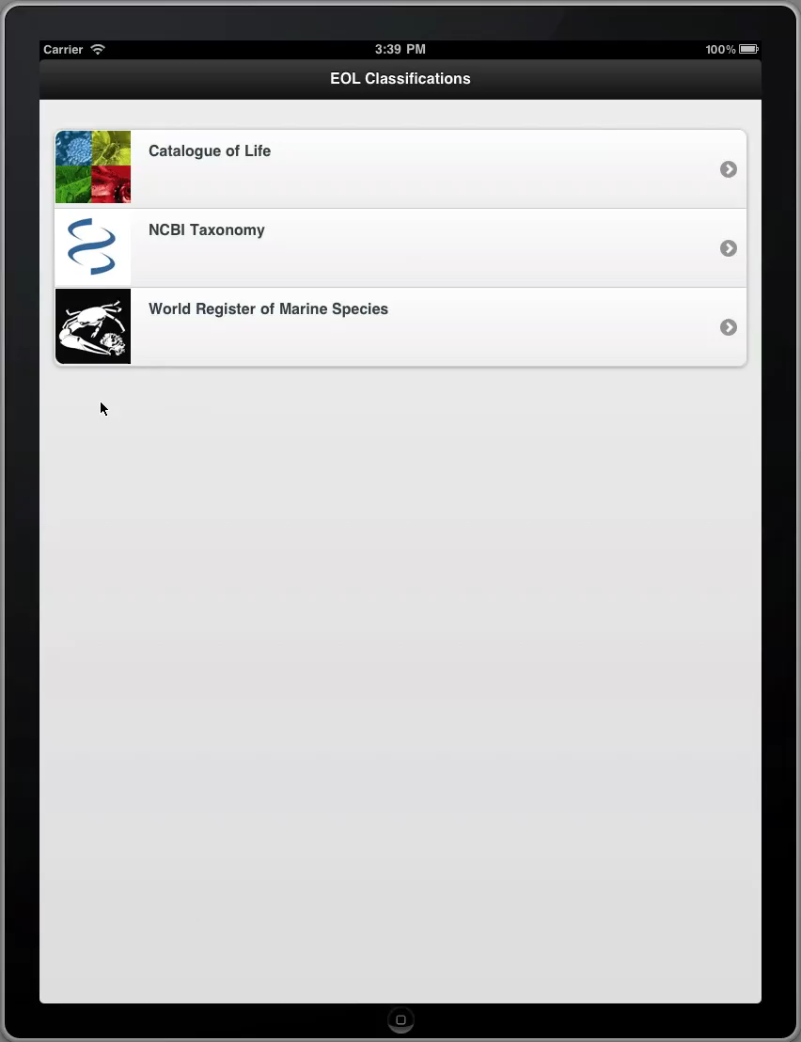

Slide 58
Taxonomy
Names
Synonyms
Classifications
Visualisation

Slide 59
Phylogeny

Slide 60
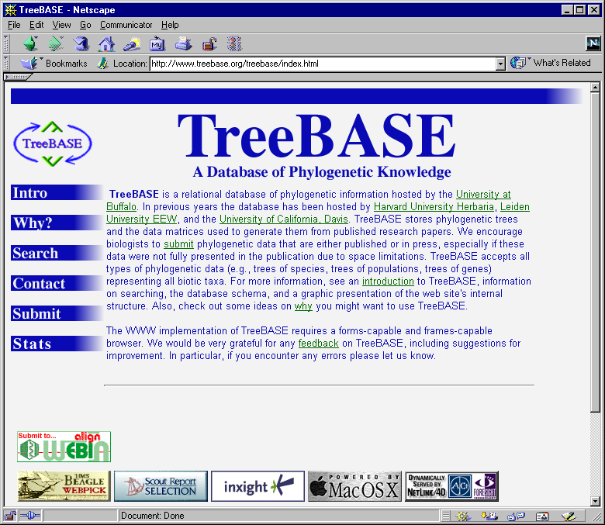

Slide 61
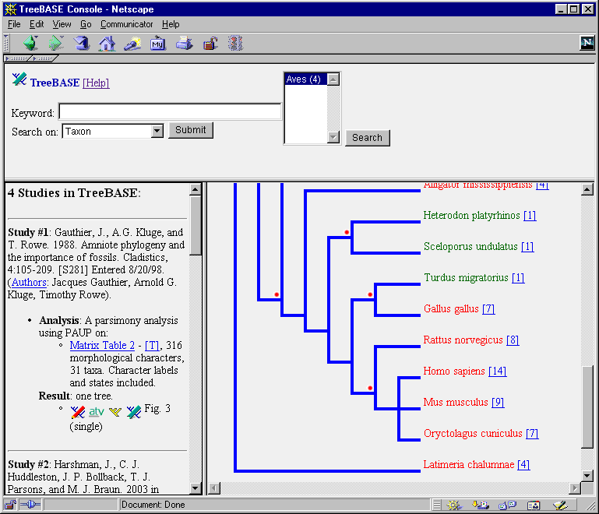
Rate of growth of phylogenetic knowledge
Number of papers with “molecular” and “phylogeny” in Web of Science
Number of studies in TreeBASE

Slide 62
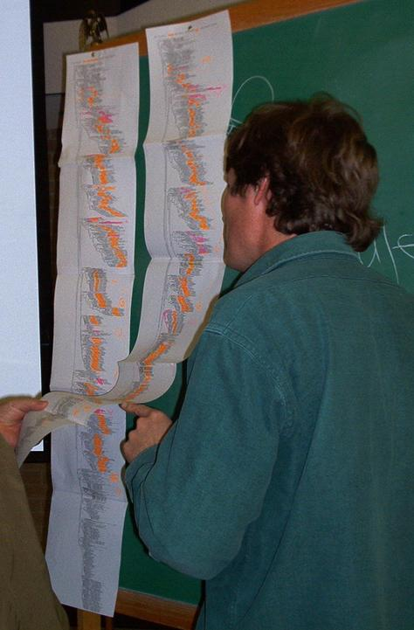

Slide 63
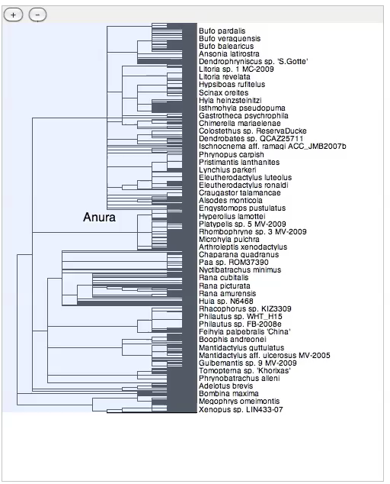

Slide 64

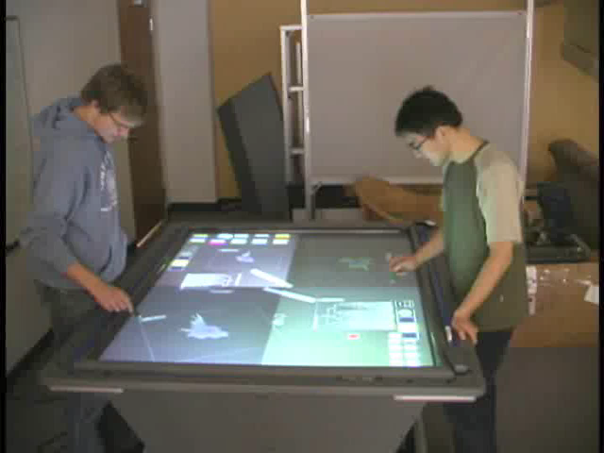
@dr_pi
Notes:
Petra Isenberg, see “Interactive tree comparison for co-located collaborative information visualization” http://www.ncbi.nlm.nih.gov/pubmed/17968069 and http://innovis.cpsc.ucalgary.ca/Research/CollaborativeTreeComparison

Slide 65
Phylogeny
Finding a phylogeny for a group of organisms
Displaying on the web (visualisation)

Slide 66
Data mining

Slide 67
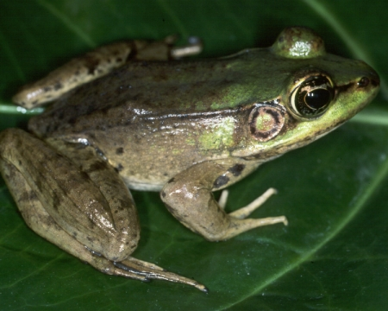

Slide 68
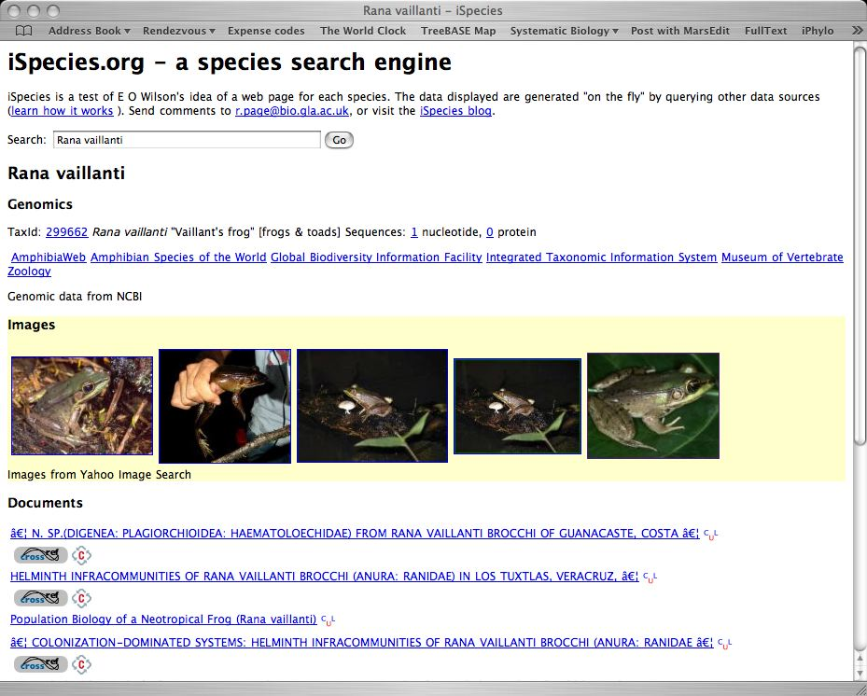
Text mining

Slide 69
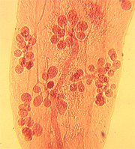
Morphological and molecular description of Haematoloechus meridionalis n. sp. (Digenea: Plagiorchioidea: Haematoloechidae) from Rana vaillanti brocchi of Guanacaste, Costa Rica
Halipegus eschi n. sp. (Digenea: Hemiuridae) in Rana vaillanti from Guanacaste Province, Costa Rica
Haematoloechus danbrooksi n. sp. (Digenea: Plagiorchioidea) from Rana vaillanti from Los Tuxtlas, Veracruz, Mexico

Slide 70
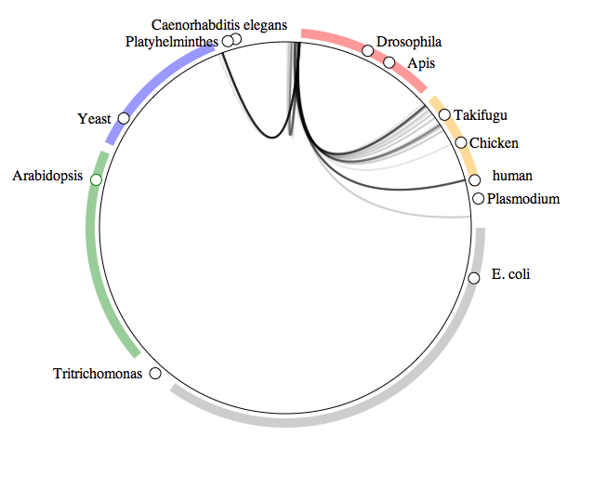
What do crustaceans live on?
Arthropods
Fungi
Vertebrates
Green
plants
Bacteria

Slide 71
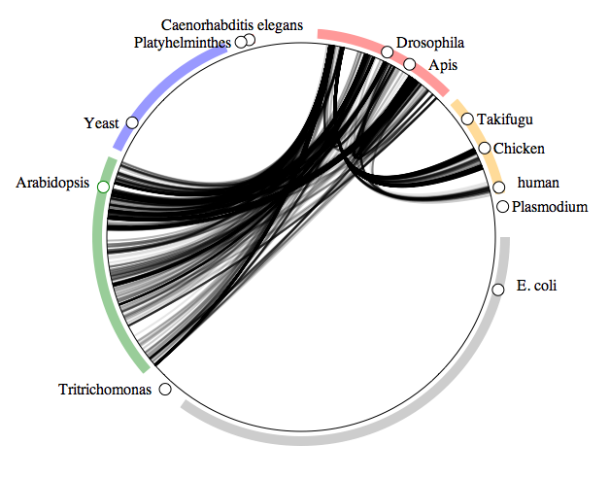
What do insects live on?
Arthropods
Fungi
Vertebrates
Green
plants
Bacteria

Slide 72
Data mining
Extracting information from the literature
Extracting information from databases

Slide 73
The End

